Slide 1

Chapter 1
Introduction
Copyright © The McGraw-Hill Companies, Inc. Permission required for reproduction or display.

Slide 2
Chapter 1
What is computer Security?
The protection of the assets of a computer system
Hardware
Software
Data
Each of these assets have different values to different members

Slide 3
Chapter 1
What is computer Security?
The protection afforded to an automated information system in order to attain the applicable objectives of preserving the integrity, availability, and confidentiality of information system resources (includes hardware, software, firmware, information / data, and telecommunications).

Slide 4
Chapter 1
What is Network Security?
It is a set of rules and configurations designed to protect the integrity, confidentiality and accessibility of computer networks and data using both software and hardware technologies.

Slide 5
Vulnerabilities, Threats, Attacks, Controls
Vulnerability is a weakness in the security system
(i.e., in procedures, design, or implementation), that might be exploited to cause loss or harm.
Threat to a computing system is a set of circumstances that has the potential to cause loss or harm.
a potential violation of security
A human (criminal) who exploits a vulnerability perpetrates an attack on the system.

Slide 6
Vulnerabilities, Threats, Attacks, Controls (Contd..)
How do we address these problems?
A control is an action, device, procedure, or technique that removes or reduces a vulnerability.
Threat is blocked by control of vulnerability
Purpose of security : to devise ways that can prevent weaknesses to be exploited

Slide 7
Types of Threats
Notes:
These are the primary types of harm against system data and functions. Understanding these possibilities is important to considering threat and risk.

Slide 8
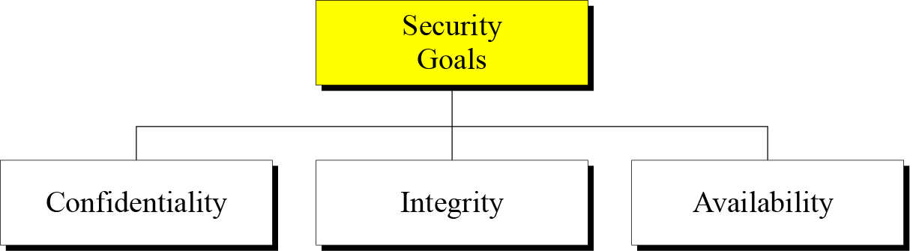
1-1 SECURITY GOALS
Non-repudiation, Authentication

Slide 9
1.1.2 Integrity
Information needs to be changed constantly.
Integrity means that changes need to be done only by authorized entities and through authorized mechanisms.

Slide 10
1.1.3 Availability
The information created and stored by an organization needs to be available to authorized entities.
Information needs to be constantly changed, which means it must be accessible to authorized entities.

Slide 11
1-2 ATTACKS
The three goals of security⎯confidentiality, integrity, and availability⎯can be threatened by security attacks.
Types of Attacks
Passive Attacks
Active Attacks

Slide 13
Difference between Passive and Active Attacks
Passive Attack | Active Attack
It makes use of information from the system but does not affect the system resources | It attempts to alter system resources or affect their operation
e.g. Eavesdropping, traffic analysis | e.g. Masqurade, replay, modification of message, denial of service
Difficult to detect as it does not alter resources/data | Difficult to prevent
Prevention mechanism like encryption is needed | Detection mechanism is needed

Slide 14
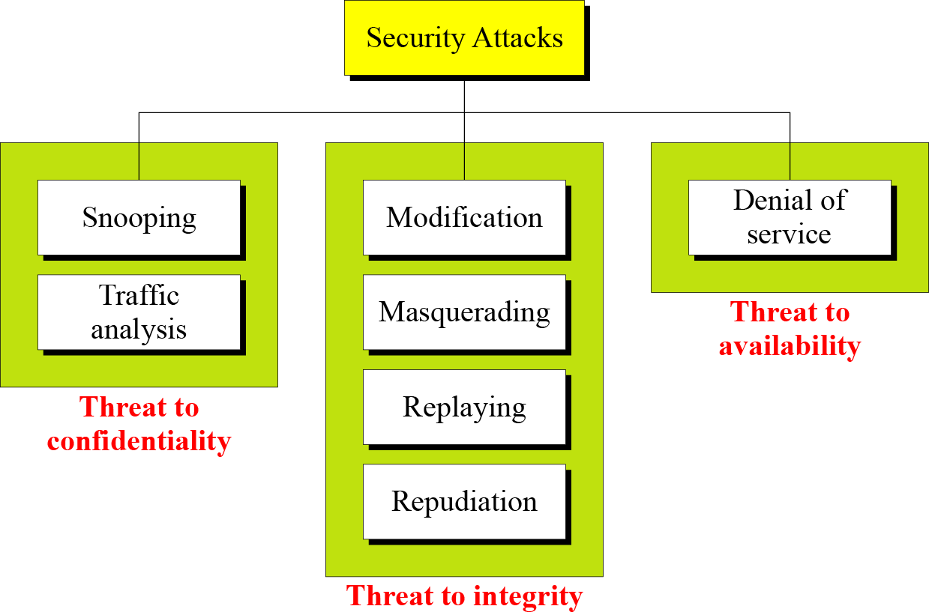
1.2 Continued
Figure 1.2 Taxonomy of attacks with relation to security goals

Slide 15
1.2.1 Attacks Threatening Confidentiality
Snooping refers to unauthorized access to or interception of data.
Traffic analysis refers to obtaining some other type of information by monitoring online traffic.

Slide 16
1.2.2 Attacks Threatening Integrity
Modification means that the attacker intercepts the message and changes it.
Masquerading or spoofing happens when the attacker impersonates somebody else.
Replaying means the attacker obtains a copy of a message sent by a user and later tries to replay it.
Repudiation means that sender of the message might later deny that she has sent the message; the receiver of the message might later deny that he has received the message.

Slide 17
Masquarade, replay, modification of message,
denial of service
Masquarade – One entity pretends to be different entity (spoofing)
E.g. Authentication sequences can be captured and replayed after a valid authentication sequence has taken place
Replay – involves passive capture of data unit and its subsequent retransmission to produce unauthorized effects

Slide 18
Masquarade, replay, modification of message,
denial of service
Modification of message – altering, reordering, delaying message
Denial of service – preventing normal use or management of services

Slide 19
1.2.4 Passive Versus Active Attacks
Table 1.1 Categorization of passive and active attacks

Slide 20
1-3 SERVICES AND MECHANISMS
ITU-T provides some security services and some mechanisms to implement those services. Security services and mechanisms are closely related because a
mechanism or combination of mechanisms are used to provide a service..
Topics discussed in this section:
1.3.1 Security Services 1.3.2 Security Mechanism 1.3.3 Relation between Services and Mechanisms

Slide 21
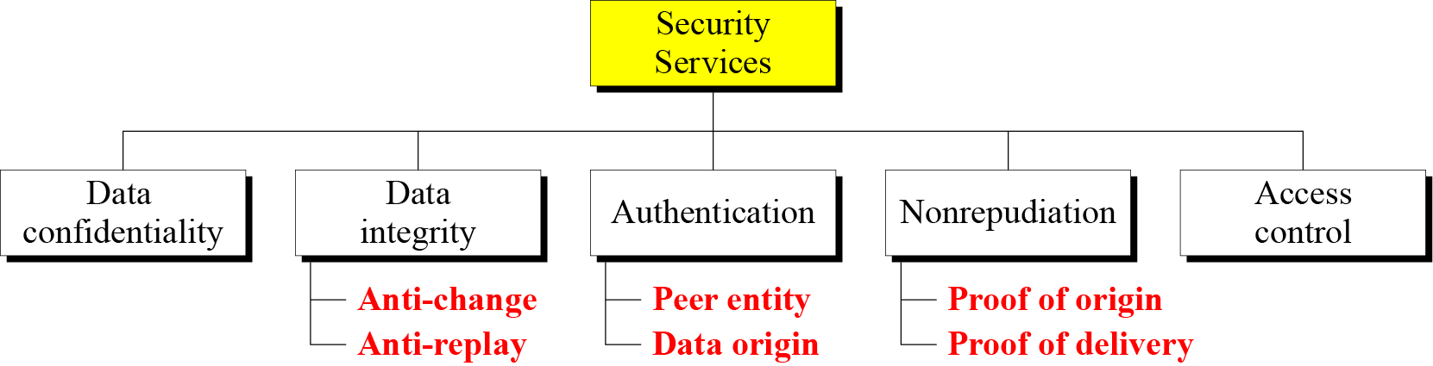
1.3.1 Security Services
Figure 1.3 Security services

Slide 22
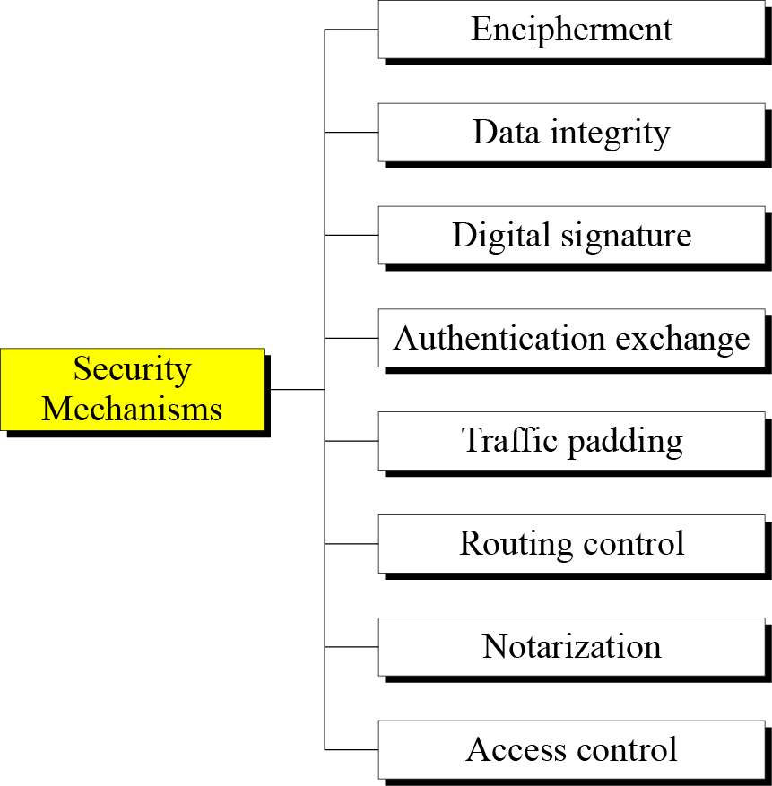
1.3.2 Security Mechanism
Figure 1.4 Security mechanisms

Slide 23
1.3.3 Relation between Services and Mechanisms
Table 1.2 Relation between security services and mechanisms

Slide 24
X.800 OSI Security Architecture
X.800, Security Architecture for OSI
systematic way of defining requirements for security and characterizing approaches to satisfying them
defines:
security attacks - compromise security
security mechanism - act to detect, prevent, recover from attack
security service - counter security attacks
Notes:
ITU-T Recommendation X.800, Security Architecture for OSI, defines a systematic way of defining the requirements for security and characterizing the approaches to satisfying those requirements. The OSI security architecture is useful to managers as a way of organizing the task of providing security. The OSI security architecture focuses on security attacks, mechanisms, and services. These can be defined briefly as:
• Security attack: Any action that compromises the security of information owned by an organization. cf. network security attacks slide earlier
• Security mechanism: A mechanism that is designed to detect, prevent, or recover from a security attack. cf. functional requirements from previous slide or Table 1.6 in text.
• Security service: A service that enhances the security of the data processing systems and the information transfers of an organization. The services are intended to counter security attacks, and they make use of one or more security mechanisms to provide the service. cf CIA security concepts earlier, or Table 1.5 in text.

Slide 25
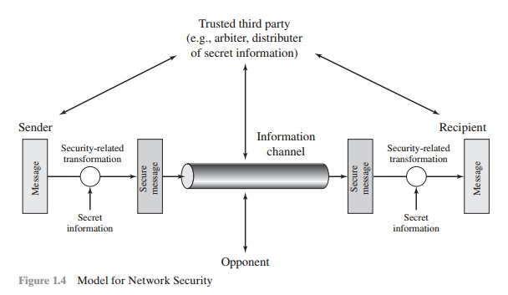
Network Security Model

Slide 26
Four basic tasks in designing a particular security service:
Design an algorithm for performing the security-related transformation. The algorithm should be such that an opponent cannot defeat its purpose.
Generate the secret information to be used with the algorithm.
Develop methods for the distribution and sharing of the secret information.
Specify a protocol to be used by the two principals that makes use of the security algorithm and the secret information to achieve a particular security service.

